Slide 1
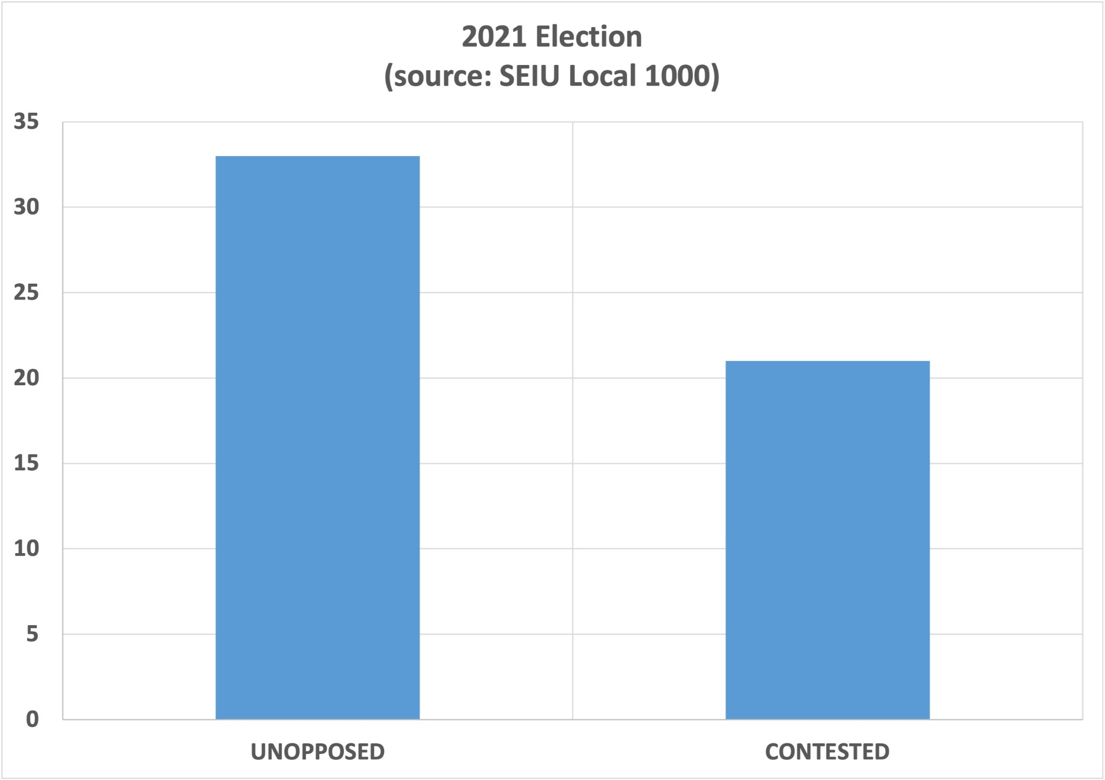

Slide 2
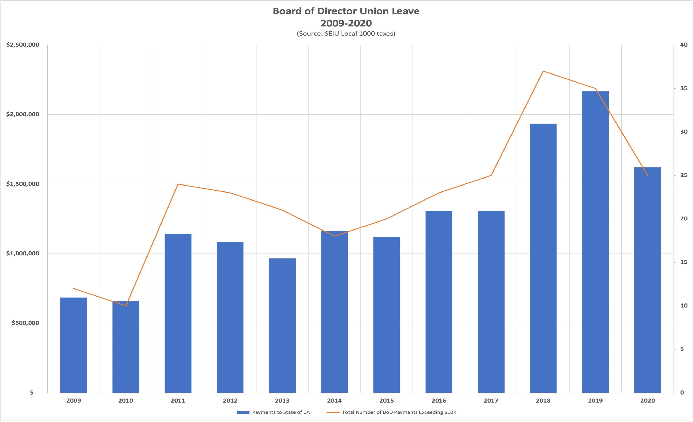

Slide 3
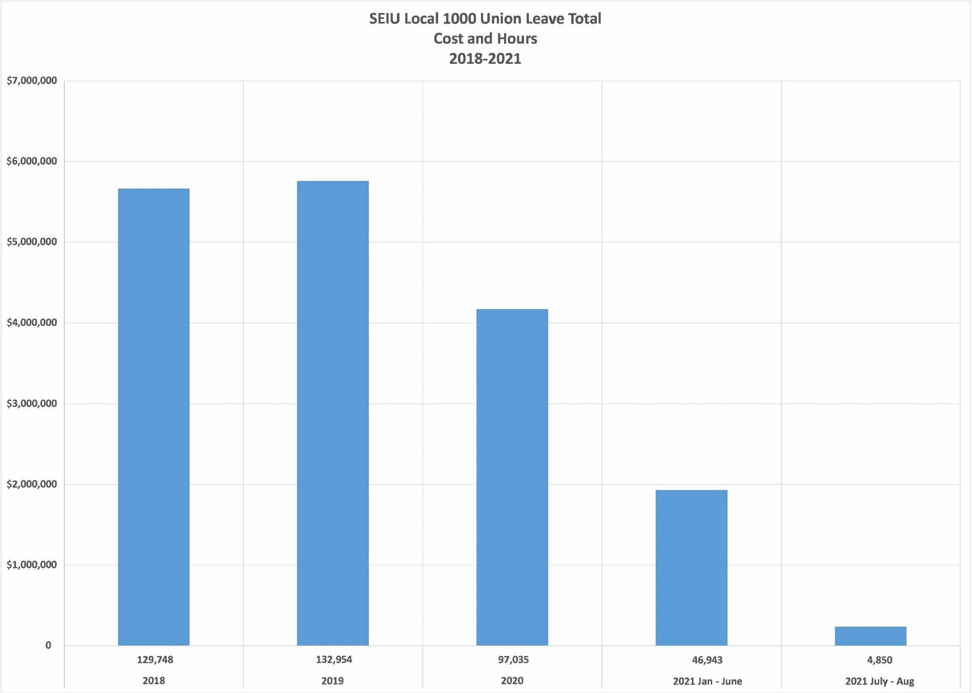

Slide 4
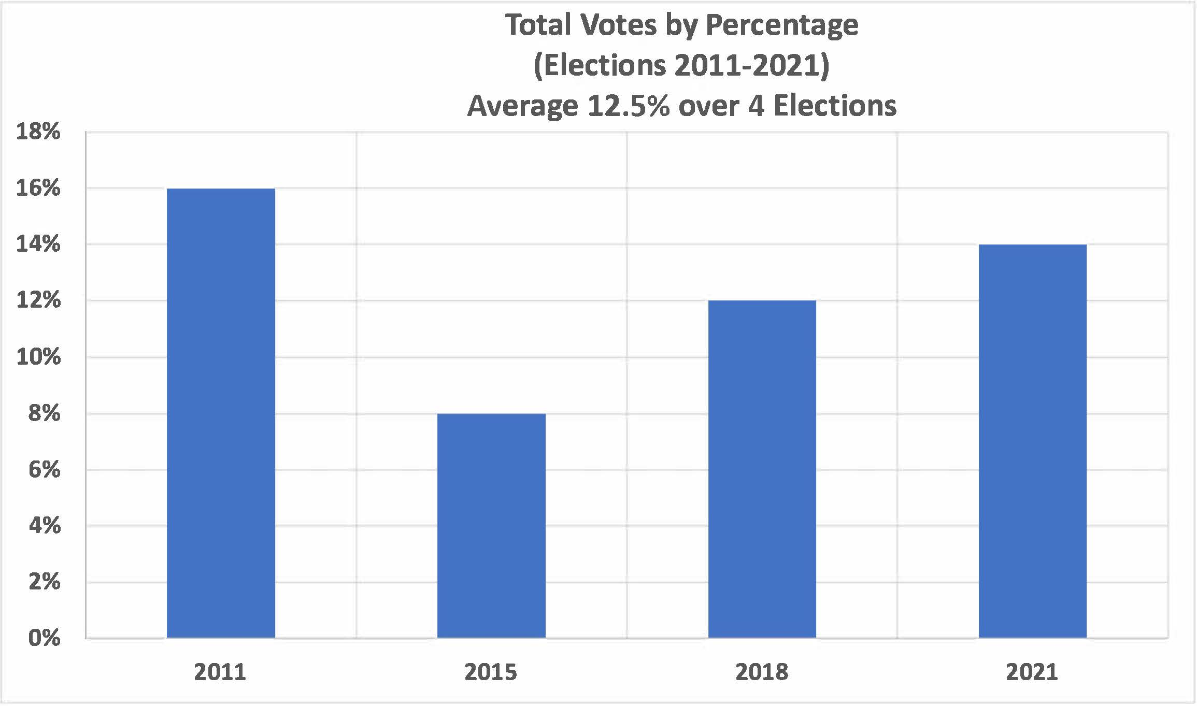

Slide 5
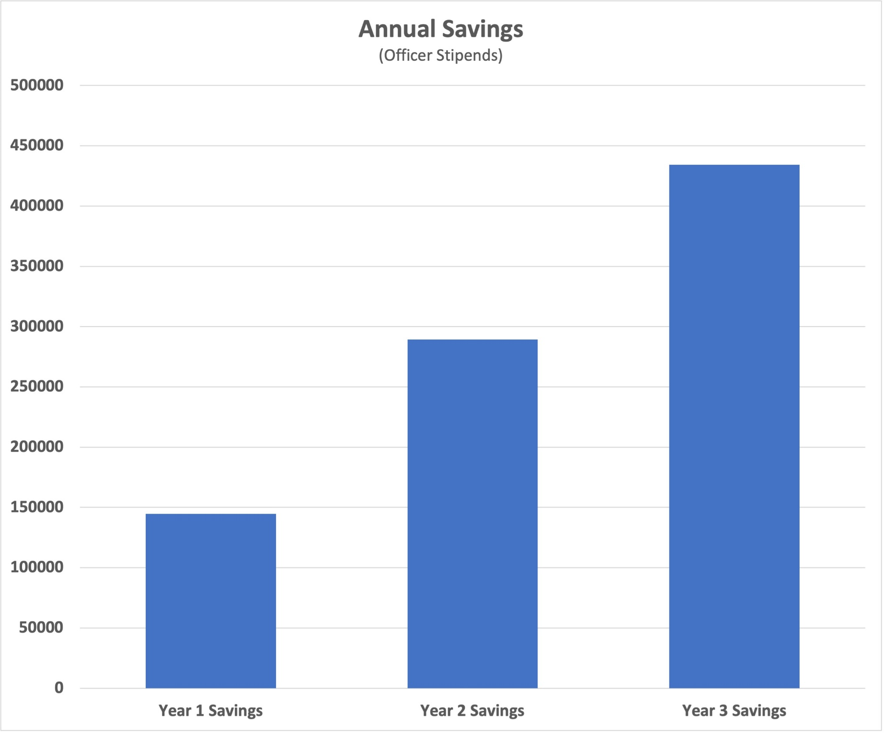

Slide 6
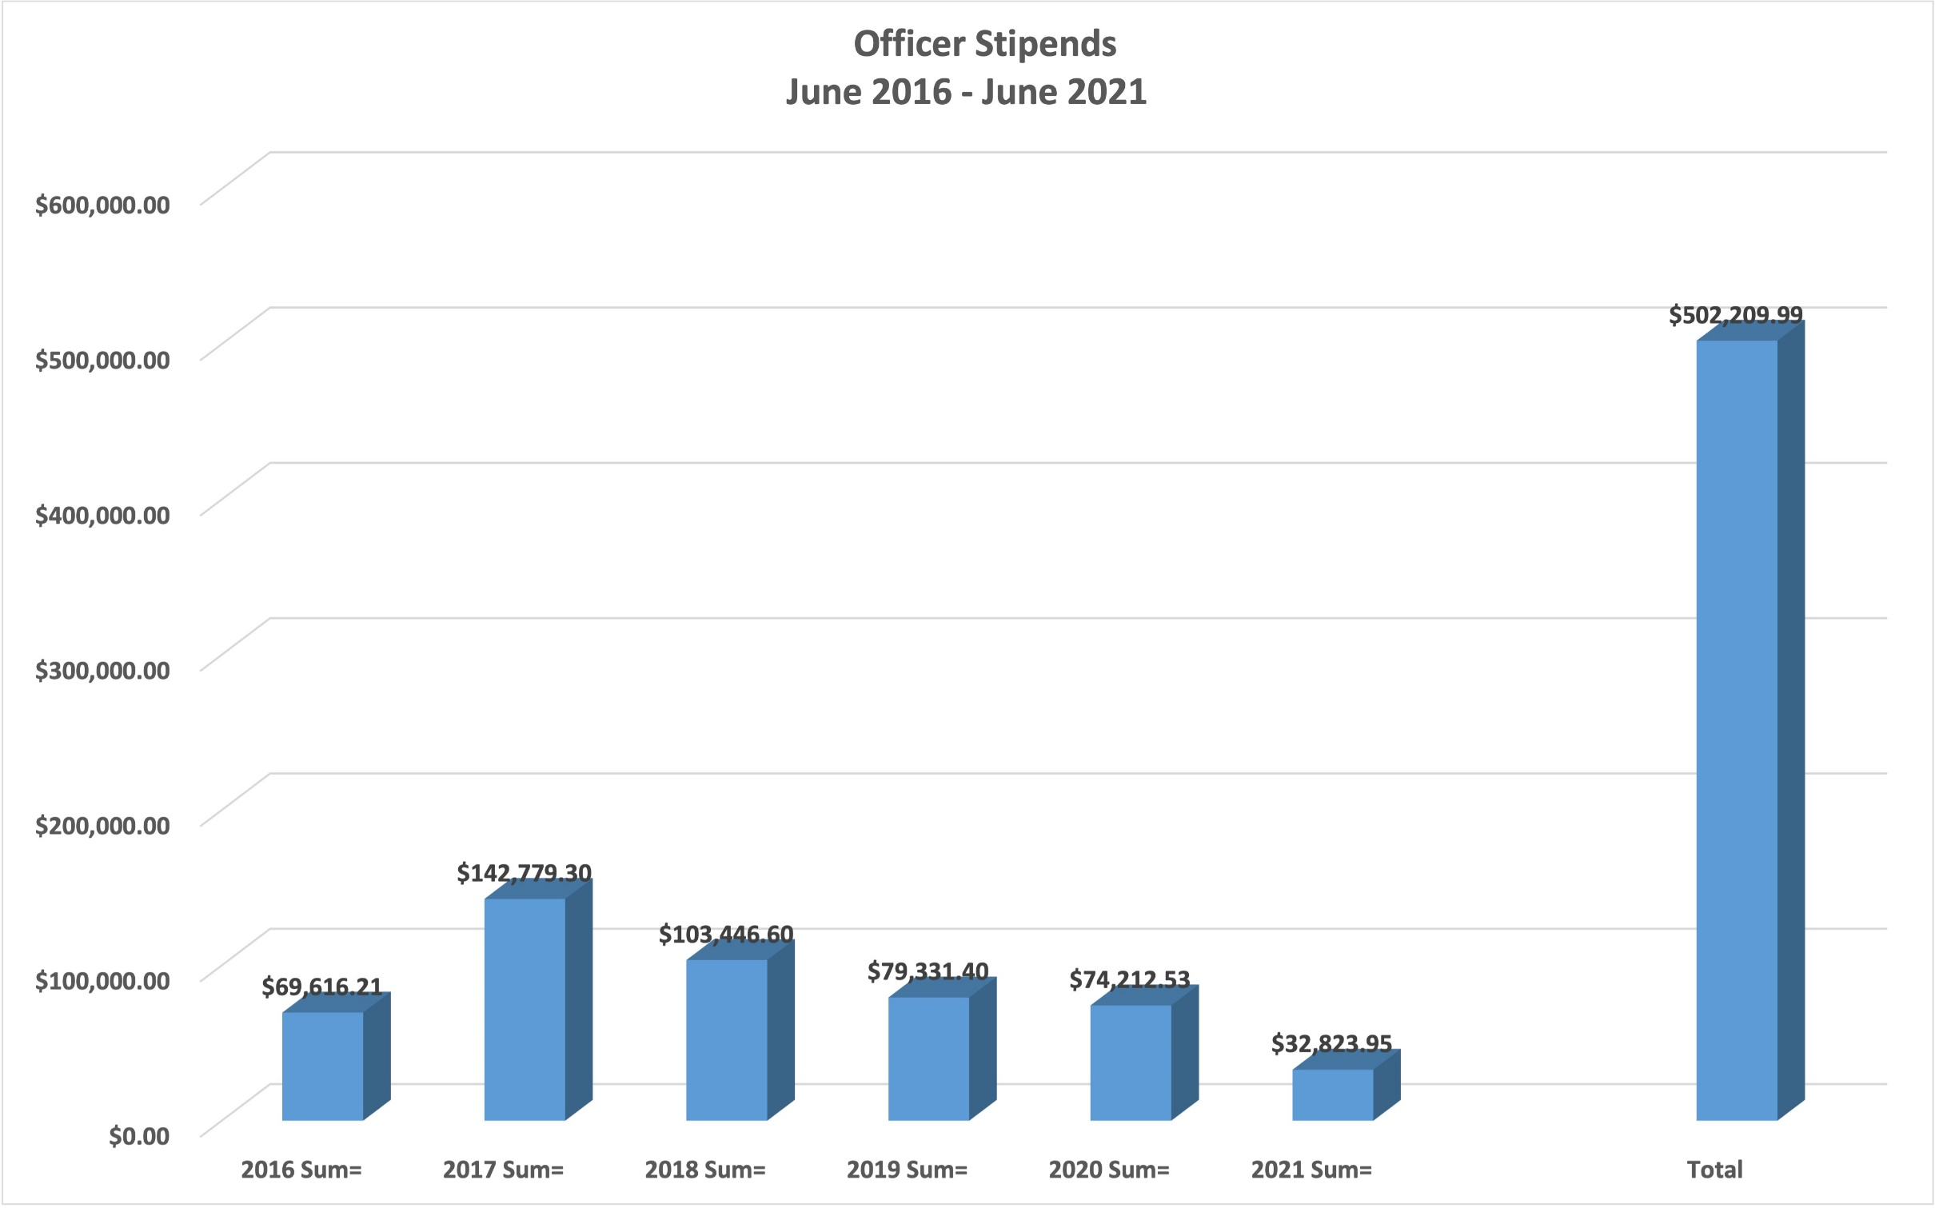

Slide 7
Turning Things Around: Multi-year declines in Membership rates
SEIU Local 1000

Slide 8
Membership rates have been falling since 2017

Slide 9
We’ve lost 3,000 members; Our membership rate has fallen since 2017
Classifications with the biggest losses:
Associate Governmental Program Analysts
Motor Vehicle Representatives
Office Technicians
Information Technology Specialists
Staff Services Analysts
Nurses
Employment Program Representatives

Slide 10
DLCs, their presidents, and Departments with the Lowest Membership Rates
762 Daunette Sparkman
764 Jennifer Cordova
765 Leonard Seitz
766 Shrhonda Ward
767 Richard Wake
786 Theresa Taylor
794 Francina Stevenson
DOT
EMSA
FTB
HCD
CHS
CDTFA
DOJ
PERS
DWR

Slide 11
We’re Researching – WHY?
We’ll be working very closely with DLC Presidents, including holding regional conference calls with DLC Presidents.
We already know the quality of representation has been a big concern for state employees.
We’ll be conducting Focus Groups with state workers and distributing surveys. Look out for the first survey to be released in a few weeks.

Slide 12
We’re creating a plan to TURN THINGS AROUND
Step #1: Acknowledge and understand the problem.
Step #2: Take down information silos and collaborate/Everyone shares what they know
Step #3: Change the culture from punitive to collaborative.
Step #4: ORGANIZE. We’ll be more strategic, and target depts. (DMV,FTB, are examples)
Step #5: Plan ahead.

Slide 13
We’re prioritizing representation and contract enforcement
WE’RE HIRING NEW UNION REPRESENTATIVES.
All Union Organizers are being trained in representation.
This means higher quality representation from better trained Union Representatives with smaller case loads.

Slide 14
INTERNAL POLITICS MUST TAKE A BACK SEAT
This could be the biggest challenge Local 1000 faces for the next few years.
It’s critical that all parts of the union including the board of directors, staff and other stakeholders put aside differences and work together.
Now is not the time for petty politics; this is the time to find a way to move forward.

Slide 15
New Statewide Ad Hoc Committee on Membership Organizing
We want to facilitate the SEIU Local 1000 Board of Director’s involvement on this issue.
VP for Representation and Organizing Anica Walls will chair.
Co-Chair and 11-15 members will be appointed by Local 1000 President. First meeting to be held by December 9th.
Committee members will have union leave to work with staff to plan, coordinate and implement strategies to recruit new members.

Slide 16
Membership Organizing Blitz
Starting November 1st.
Targeting large worksites (250+) and digital organizing efforts.
Will run through the end of the year.
To get involved contact: Theodros Gashaw, Tgashaw@seiu1000.org

Slide 17
Begin Planning a Multi-Year Strategy
Work with the DLC Presidents to begin strategic planning around increasing membership rates
All of our staff from the field, communications, research, IT, etc. are working to create a strategy to increase membership for years to come.
Training Union Representatives
Training DLC Presidents and E-boards (just debuted new charting and mapping training)

